Slide 1

Airbnb In New York City
Group 10: Ruiqi Xie, Jeffrey Chan, Cindy Huang

Slide 2


OUR GOAL:
Since 2008, guests and hosts have used Airbnb to expand on traveling possibilities and present a more unique, personalized way of experiencing the world.
Airbnb now offer over 7 million accommodations and 50,000 unique activities.
We are interested in the hotels and places to start our business in New York City as an Airbnb host, so we found the dataset which describes the listing activity and metrics in NYC, NY for 2019 and 2020.
Our goal is to analyze which neighborhood group is a good place to start at. And have some insights of how demand changes through time.
Notes:
Since 2008, guests and hosts have used Airbnb to expand on traveling possibilities and present a more unique, personalized way of experiencing the world. Airbnb has become one of the world’s largest marketplace for travelers to find suitable, reliable places to stay and things to do.
Since Airbnb opening, they now offer over 7 million accommodations and 50,000 unique activities, all powered through local entrepreneurs and hosts. We are interested in the hotels and places to start our business in New York City as an Airbnb host, so we found the dataset which describes the listing activity and metrics in NYC, NY for 2019 and 2020.

Slide 3
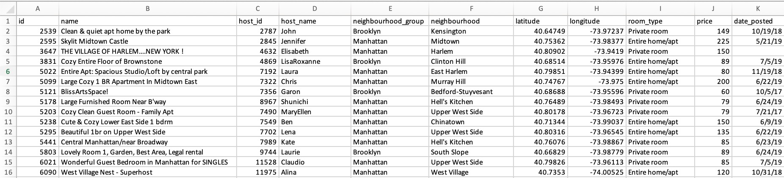
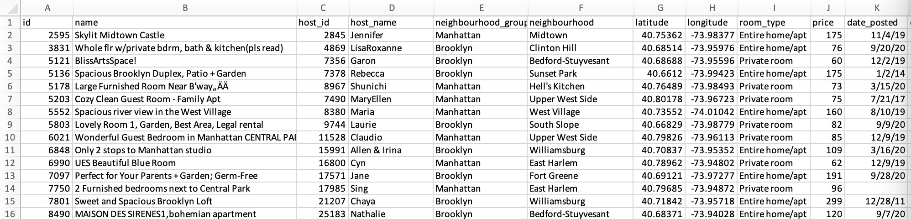

Airbnb_NYC_2019
Airbnb_NYC_2020
Data set from: https://www.kaggle.com/dgomonov/new-york-city-airbnb-open-data

Slide 4
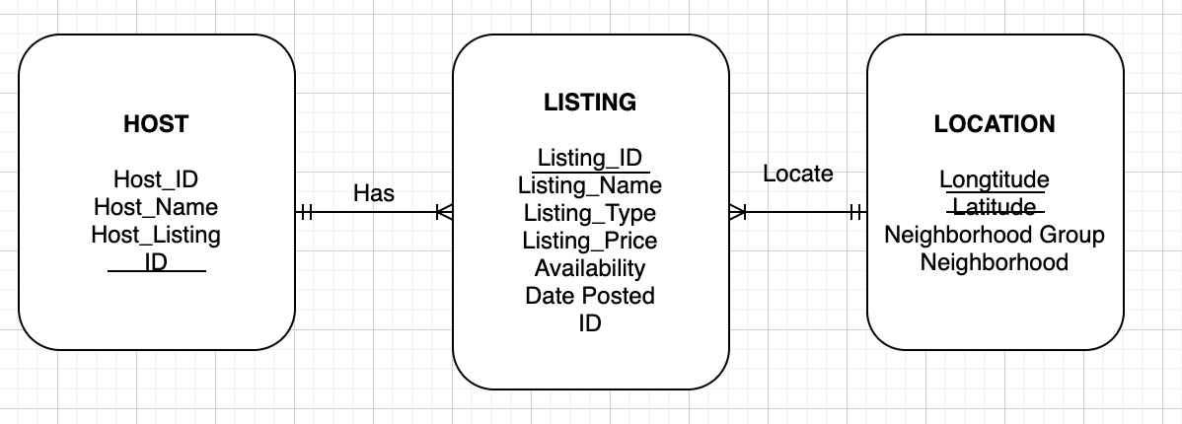
ER Diagram

Slide 5
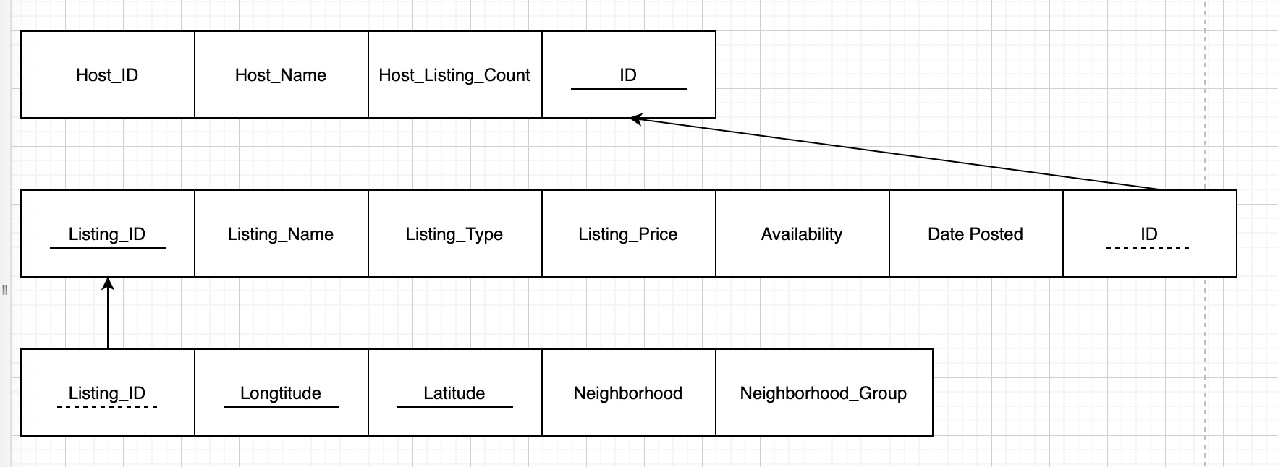
Relational Schema

Slide 6
Analysis Problems
Neighborhood Group(Number of Listings & Price )
Which neighborhood Group are the hotspots in New York?
Which neighborhood Group has the highest average price of listings?
Which room types are in the highest demand ?
What is the average price of each room type in each neighborhood group?
How is the price changing from 2019 to 2020?
Which month has the highest amount of listings?
Room Type(demand & price)
Date (Price & Postings)
Notes:
- first 2 questions are an overview of NYC. 3 and 4 are going into the specifics of room types. 5 and 6 are doing a time series analysis, how the airbnb situation changed throughout 2019 and 2020.

Slide 7
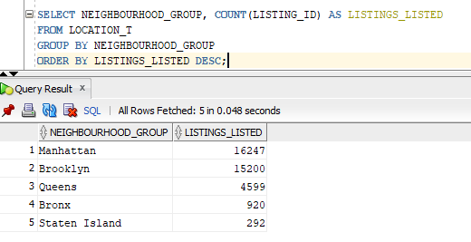
Problem 1
Which Neighborhood Group are the hotspots in New York(most listings posted)?
Hottest Neighborhood Group:
1. Manhattan –16,247
2. Brooklyn—15,200

Slide 8
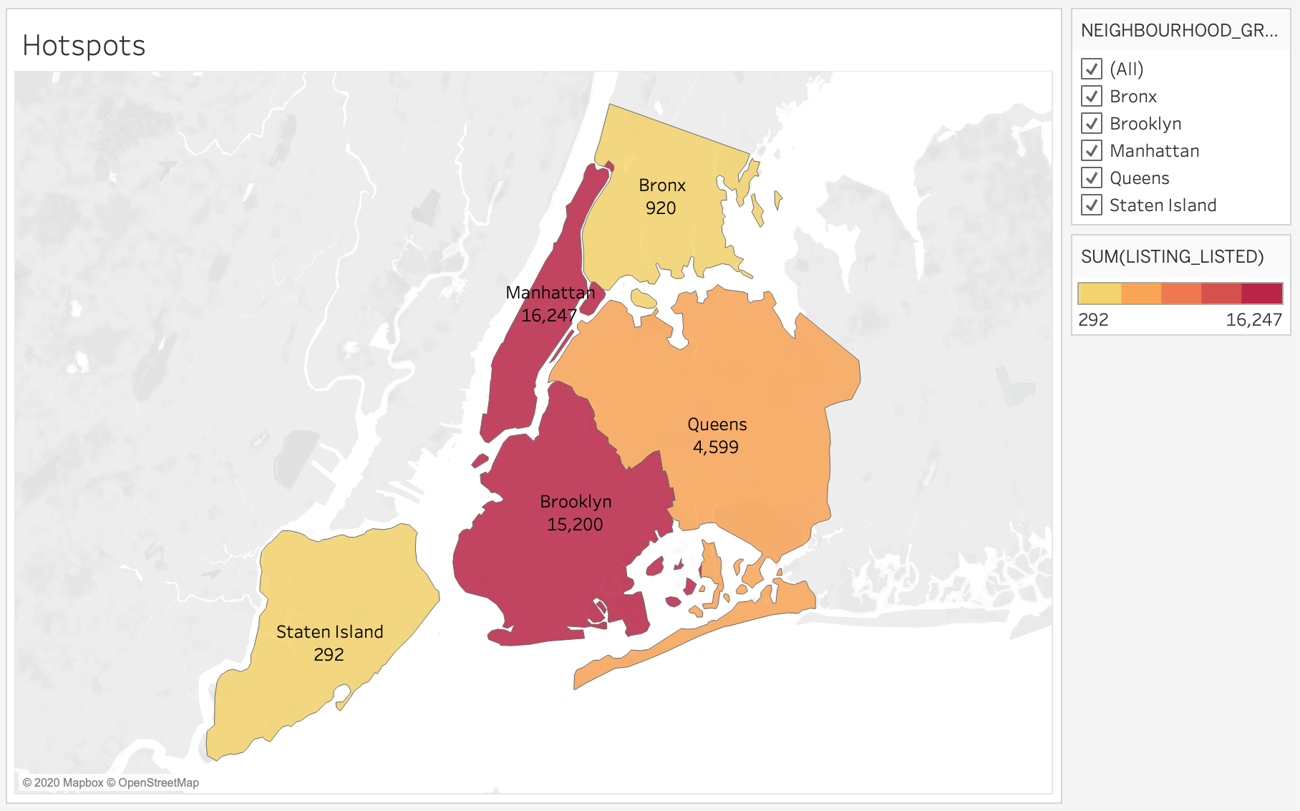
Problem 1
Which neighborhood Group are the hotspots in New York(most listings posted)?
It can be also seen in Heatmap. Manhattan has darkest color and then Brooklyn.

Slide 9
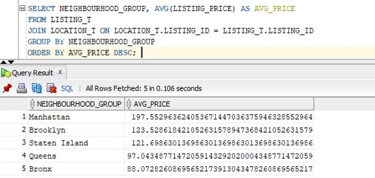
Problem 2
Which neighborhood Group has the highest average price of listings?
Highest average price:
1. Manhattan $197.55
2. Brooklyn $123.53
3. Staten Island $121.70

Slide 10
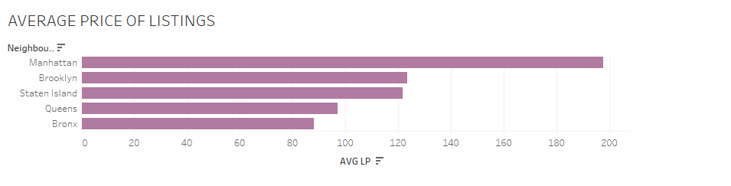
Problem 2
Which neighborhood group has the highest average price of listings?

Slide 11
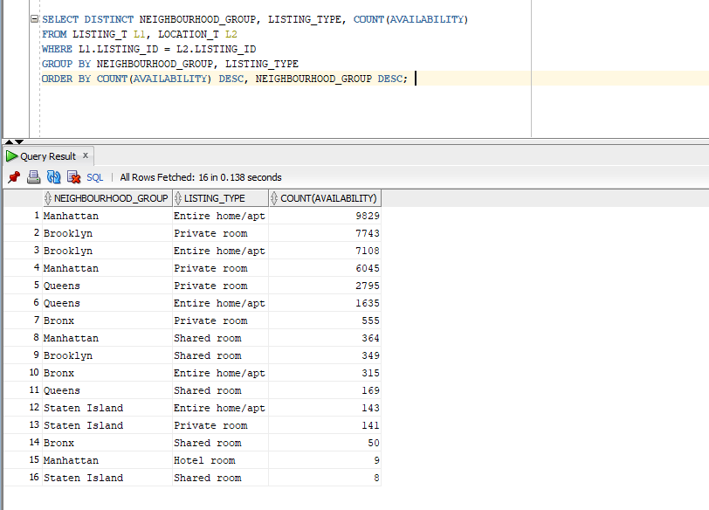
Problem 3
Which room type is the most popular in each neighborhood group?
Notes:
I will be focusing on room type and their effect on demand and prices. There are four different room types AIRBNB users can select: entire home/apartment, hotel room, private room, or shared room.
Our first analysis ask which room types are most popular in each neighborhood group (Bronx, Brooklyn, Manhattan, Queens, and Staten Island). To find this out, we selected the neighborhood groups, listing type (which is room type), and counted the days available from the Listing table and the Location table and you can see the results from the query there.
We found that in Bronx, shared rooms were the least readily available, therefore the most rented out; Brooklyn, shared rooms were also the least readily available; Manhattan, hotel rooms were the least readily available; Queens, shared rooms were the least readily available, and in Staten Island (it’s a little hard to see) but shared rooms were the least readily available to users (only by like 2 points).

Slide 12
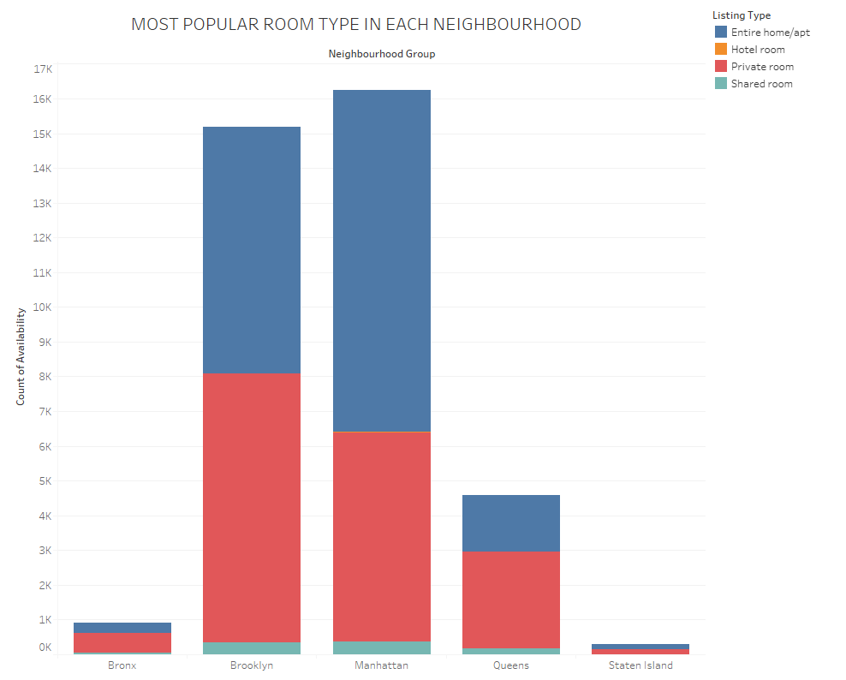
Problem 3
Which room types most popular in each neighborhood group?
Notes:
I will be focusing on room type and their effect on demand and prices. There are four different room types AIRBNB users can select: entire home/apartment, hotel room, private room, or shared room.
Our first analysis ask which room types are most popular in each neighborhood group (Bronx, Brooklyn, Manhattan, Queens, and Staten Island). To find this out, we selected the neighborhood groups, listing type (which is room type), and counted the days available from the Listing table and the Location table and you can see the results from the query there.
We found that in Bronx, shared rooms were the least readily available, therefore the most rented out; Brooklyn, shared rooms were also the least readily available; Manhattan, hotel rooms were the least readily available; Queens, shared rooms were the least readily available, and in Staten Island (it’s a little hard to see) but shared rooms were the least readily available to users (only by like 2 points).

Slide 13
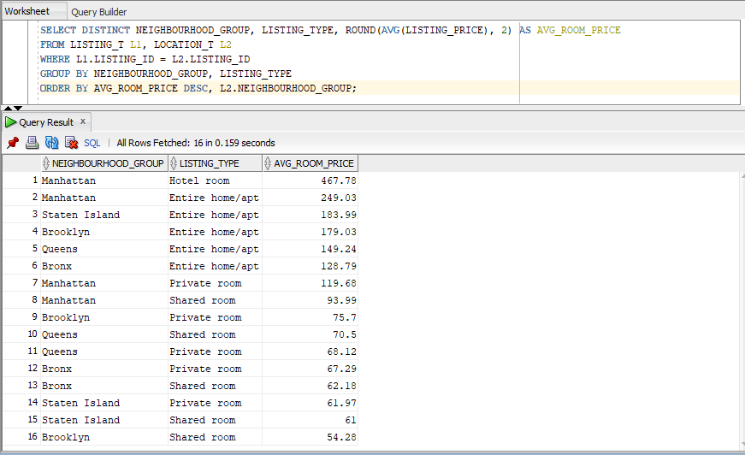
Problem 4
What is the average price of each room type in each neighborhood group?
Notes:
Our second question then ask what the average price of each room type in each neighborhood is. To figure this out, we selected neighborhood groups, listing types or room type, and the average of the listing price and saved it as the variable (AVG_ROOM_PRICE). You can see the results here in the query.
We found it interesting that Manhattan had the highest average price in all the room types out of all the neighborhoods. We hypothesis that this may be because of the high level of tourism in Manhattan vs the more residential areas of the Bronx, Brooklyn, Queens, and Staten Island. Manhattan is often referred to as “the City” and is often described as the cultural, financial, media, and entertainment capital of the world.

Slide 14
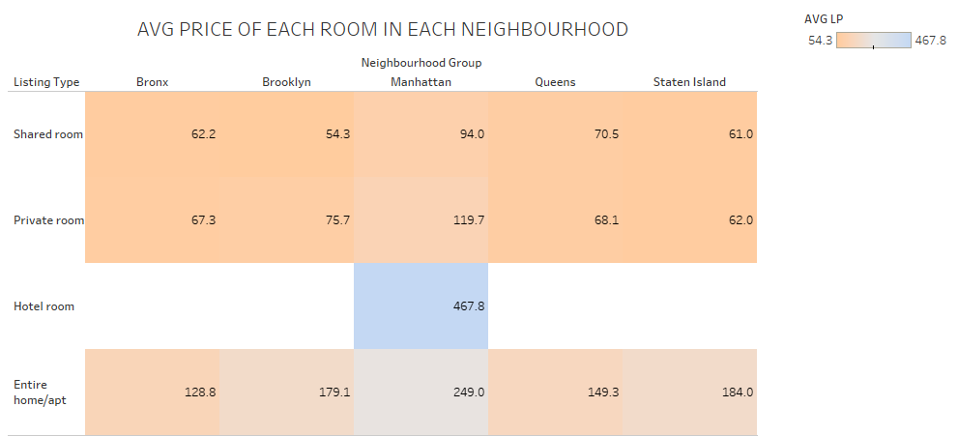
Problem 4
What is the average price of each room type in each neighborhood group?
Notes:
Our second question then ask what the average price of each room type in each neighborhood is. To figure this out, we selected neighborhood groups, listing types or room type, and the average of the listing price and saved it as the variable (AVG_ROOM_PRICE). You can see the results here in the query.
We found it interesting that Manhattan had the highest average price in all the room types out of all the neighborhoods. We hypothesis that this may be because of the high level of tourism in Manhattan vs the more residential areas of the Bronx, Brooklyn, Queens, and Staten Island. Manhattan is often referred to as “the City” and is often described as the cultural, financial, media, and entertainment capital of the world.

Slide 15
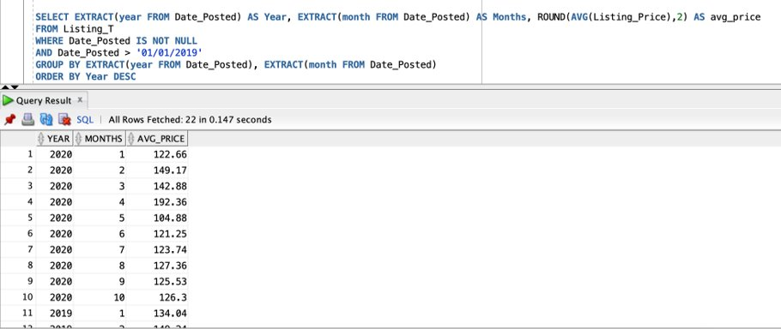
Problem 5
How does the average monthly price change from 2019 to 2020?

Slide 16
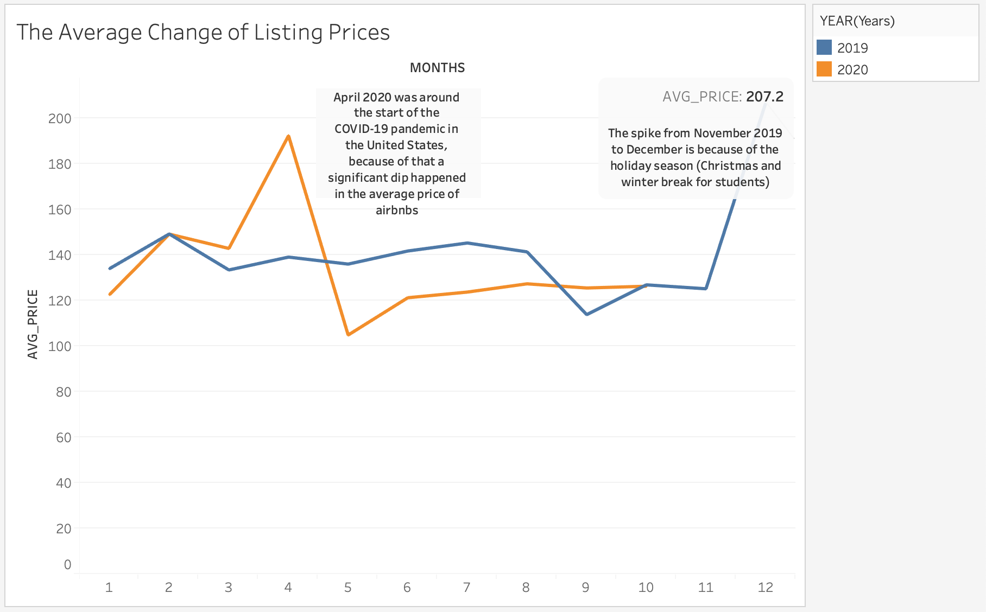
Notes:
- Overall the average price in 2019 is stable, hovering around $120 - $140, aside from the holiday season.
- Comparing May to August from 2019 to 2020, we can see that the average price in 2020 is lower than 2019 because of the low demand caused by the pandemic, plus New York was particularly hard hitted.

Slide 17
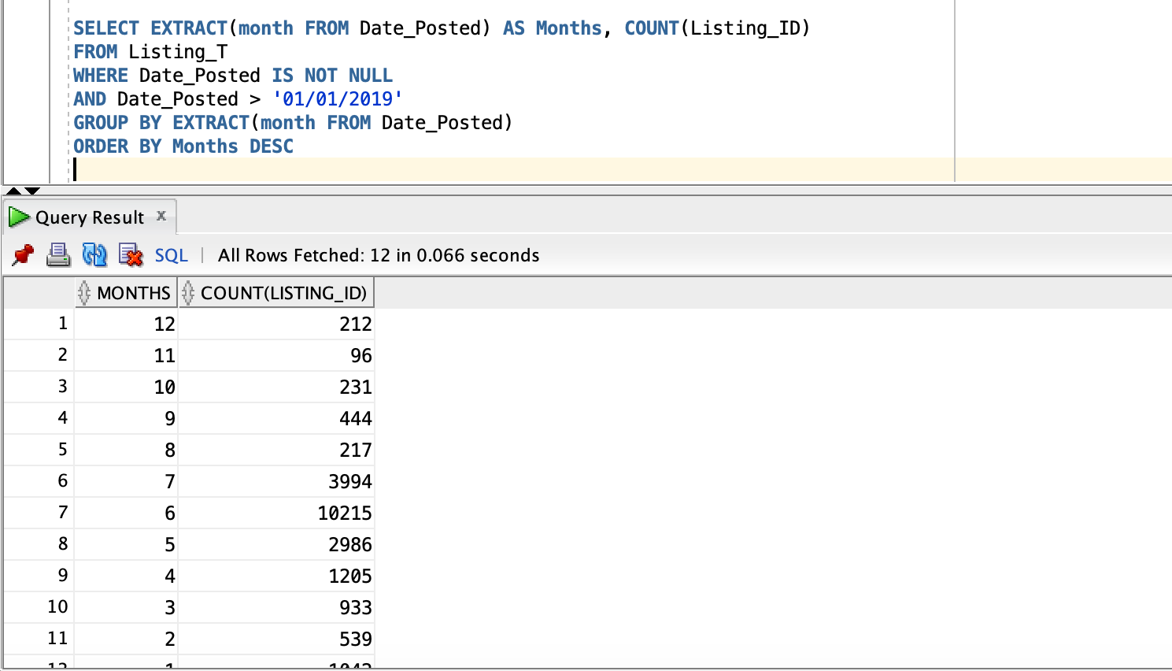
Problem 6
Which month has the highest amount of listings?
Which month of the year has the most listings?

Slide 18
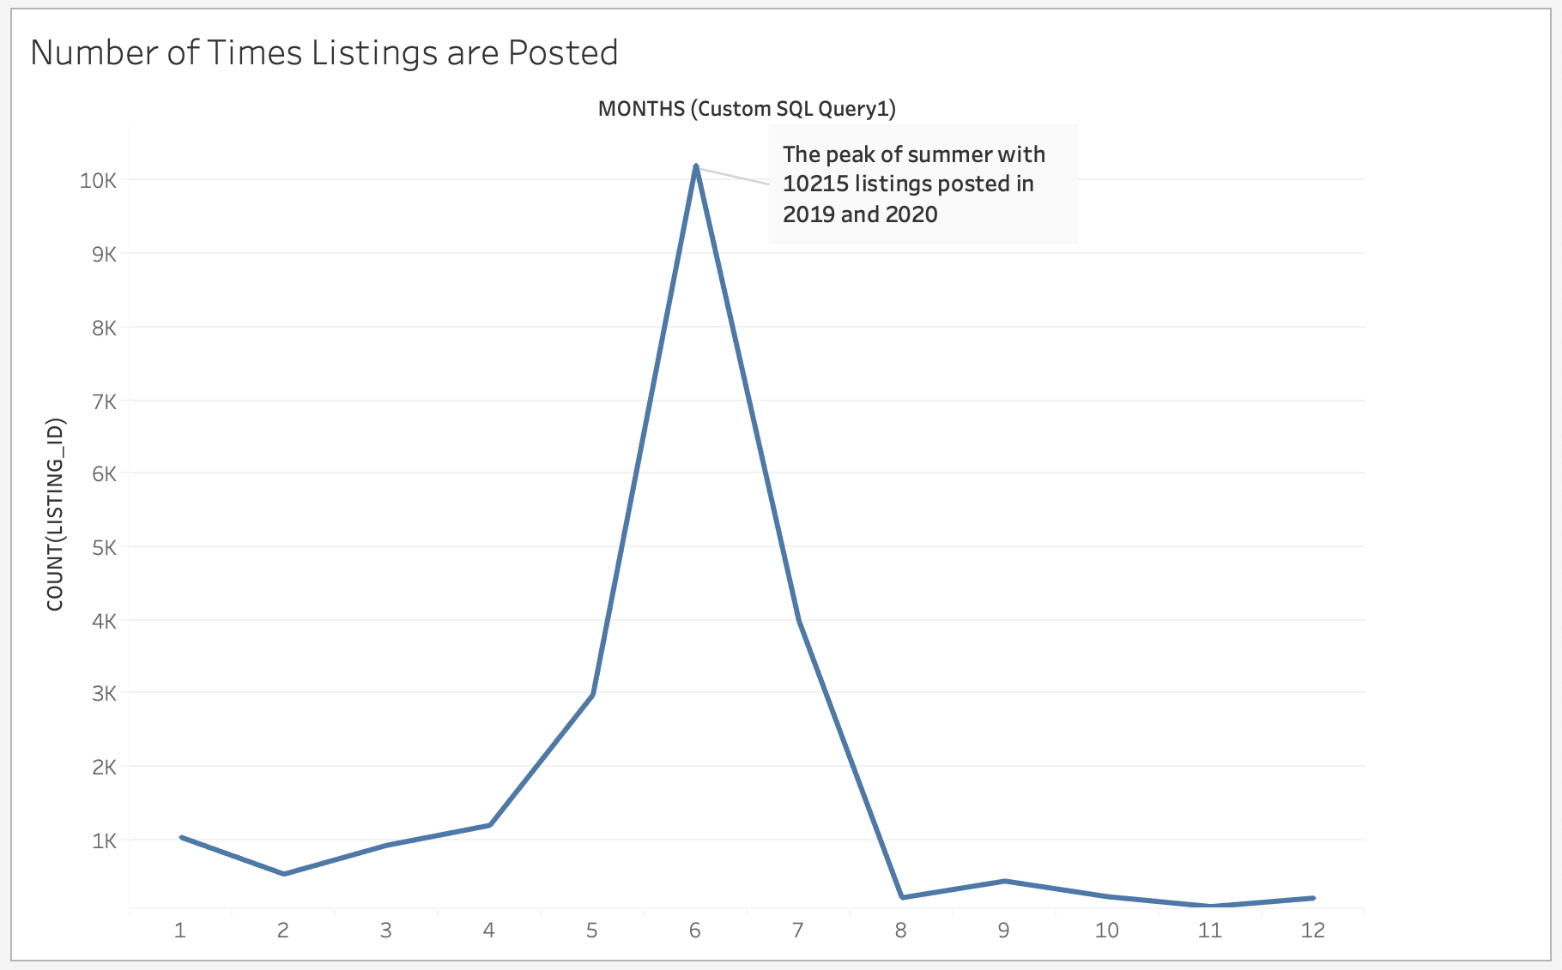
Notes:
- The number of listings start increasing from around April and May because summer is approaching and New York is one of the most popular spots for summer vacation. Property owner are seizing the opportunity to post as much listings as they can.
- The lowest point is actually in November, right before Christmas.

Slide 19
Analysis Conclusion
Where should we start an Airbnb listing?
- Manhattan.
High demand ==> High prices ==> higher profit
When should we post listing?
- During winter season
Notes:
https://photographyunfolded.com/2018/11/27/the-best-cityscapes-in-new-york-city/

Slide 20

Thank you

